Slide 1
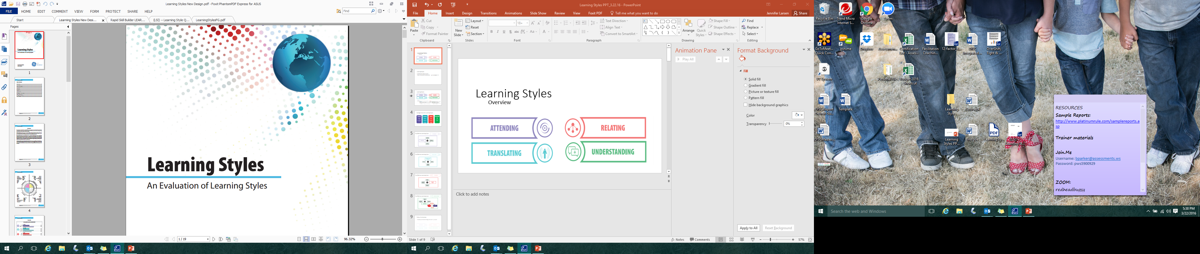

Hartman Value Profile An Evaluation of Thinking Styles

Slide 2
Thinking Science
Dr. Robert S. Hartman
The ability to measure judgment was developed by Robert S. Hartman in the late 1950’s.
Dr Hartman earned a Nobel Nomination in 1973 for his research that discovered a universal mechanism by all rational human beings used to formulate decisions.
Through this discovery, Dr. Hartman was able to calculate and measure with incredible accuracy and mathematical precision that mechanism.
Wayne Carpenter
35 years of non-stop validation, application and translation furthered Dr. Hartman’s work
First computerized analysis using the terms "Empathy", "Practical Thinking", "Systems Judgment", "Self Esteem", "Role Awareness", and "Self Direction“
Brought utilization of Clarity, Attention and Balance for analyzing and teaching axiological interpretations
©2016 Assessments 24X7
Notes:
HVP built on that every concept has the following types of value:
The value of its uniqueness,
The value of its function or role, and
The value of its meaning and purpose

Slide 3

The Hartman Value Profile (HVP) measures a person’s capacity to make value judgments about the world and one’s self.
Better Judgment means Better Decisions
©2016 Assessments 24X7
Notes:
Better judgment means better decisions:
Over or under biases in judgment can lead to riskier decisions
Weakness in judgment leaves a risk for making poor decisions which lead to poor performance
When we understand potential limitation and blind spots, we can account for them to make better decisions consciously.
Decisions always precede actions; actions should be focused on using our strengths and minimizing limitations, and results will be dependent on the critical thinking and decision making skills we harness and apply to a situation.

Slide 4
Hartman Value Profile
The assessment report captures an individual's preference to specific world and self thinking dimensions through clarity and attention measures.
Thinking and mental processing ability, like musical talent or sports talent, can be learned and improved.
Your overall thinking style is a result of the blend of your world and self thinking processes.
©2016 Assessments 24X7
Notes:
The assessment report documents your brain's natural selection process when making decisions. Understanding the ability to process information is directly linked to strengths and potential blocks to performance.
Thinking and mental processing ability, like musical talent or sports talent, can be learned and improved. Your thinking ability is reflected in how you access these talents, skills, and attitudes. Remember, some talents can be great assets in some situations, but can become a hindrance in other situations.
Our preferences influence and impact one another and are applied directly to how we view and interact with the external world and our internal self; it is the blend that creates our overall thinking style

Slide 5
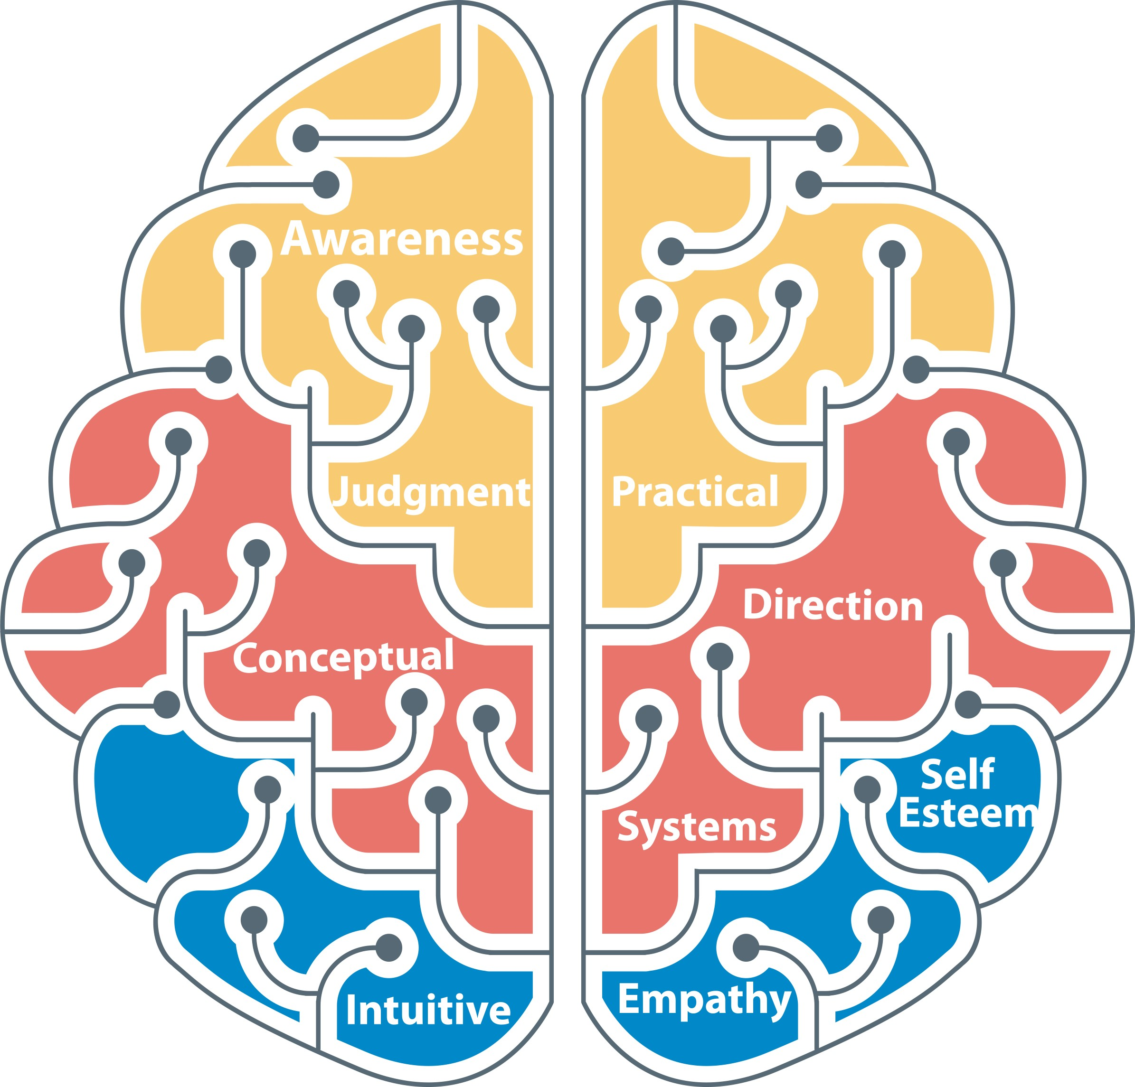
Important Notes
HVP IS NOT:
a traditional self-assessment
a 360° assessment
a skills/aptitude test
an IQ test
a behavioral assessment
HVP IS:
a forced ranking assessment that objectively examines your thinking ability
©2016 Assessments 24X7

Slide 6
External and Internal Processing
Our Judgment is comprised of both External (world) and Internal (self) processing of three core thinking dimensions – People, Tasks, and Systems:
People (Intuitive Thinking) is measured by assessing Empathy and Self Esteem
Tasks (Practical Thinking) is measured by assessing Practical Judgment and Role Awareness
Systems (Conceptual Thinking) is measured using Systems Judgment and Self Direction
Why would it be important to understand our External (world) and Internal (Self) processing?
©2016 Assessments 24X7

Slide 7
Thinking Style Dimensions
Core Dimensions World Dimensions Self Dimensions
PEOPLE Intuitive Thinking | Empathy Ability to see, understand, appreciate, and value others. Ability to relate easily to and make intuitive judgments about others. | Self Esteem Ability to see, understand, appreciate, and accept one's worth as a unique individual.
TASKS Practical Thinking | Practical Judgment Ability to see, understand, appreciate the practical, functional worth of material things. Ability to execute tasks and operational activities to attain short-term results. | Role Awareness Ability to see and understand one's functional worth, one's social or job role, and one's place in the world.
SYSTEMS Conceptual Thinking | System Judgment Ability to see, understand, and appreciate the need for systems, order, structure and standards. Aptitude for conceptual, strategic thinking and planning to attain long-term results, big picture thinking. | Self-Direction/Future View Ability to see and understand one's sense of mission and commitment to inner ideas. Ability to be perceptive about self-concept and purpose.
©2016 Assessments 24X7
Notes:
Empathy: How you understand and value the impact your decisions will have on other people and the importance you assign to others as you make choices.
Self-Esteem: How you currently understand and value yourself.
Practical Judgment: How you understand and value results oriented, comparative choices and the importance you assign to results as you make decisions.
Role Awareness: How you understand and value your current role(s) in life.
Systems Judgment: How you understand and value structure and rules and the importance you assign to the rules as you make choices.
Self-Direction/Future View: How you understand and value your future and the importance you place on your view for how that future ought to be.

Slide 8
Clarity
Clarity:
a measure of your natural ability to see and understand. The greater your clarity the more accuracy and precision you have in the judgments that are made in that dimension.
Crystal Clear
Clear
Visible
Transition
Unconventional (World Dimension Only)
©2016 Assessments 24X7
Notes:
Clarity is a measure of your natural ability to see and understand each value dimension. The greater your clarity the more accuracy and precision you have in the judgments that are made in that dimension. Each level of clarity has its own strengths and limitations.
Crystal Clear: The ability to be very insightful, to distinguish differences both good and bad, and to be sensitive to all aspects of the dimension.
Clear: The ability to be in touch with key aspects of the dimension but to overlook some aspects due to allowing some information in and filtering other information out.
Visible: The ability to be in touch with and distinguish some specific aspects of a dimension clearly but overlook or not see other aspects due to selective filtering. Transition: Indicates the value dimension in question is likely to result in inaccurate or inconsistent decision making leading to mistakes in judgment. Unconventional (World Dimension Only): The classification of unconventional represents 'out-of-the-box' thinking or mindset. It indicates your natural ability to see things and respond to them in ways which others overlook because you think differently than others

Slide 9
Attention
Attention:
a measure of your natural ability to attend to, or pay attention to, specific information to make a decision.
Over Attentive
Attentive
Cautious
Inattentive
©2016 Assessments 24X7
Notes:
Attention is a measure of your natural ability to filter data and information to make a decision. Like clarity, attentiveness or inattentiveness can be a strength or a limitation depending on the demands of the environment and degree of balance with the other dimensions.
Over Attentive: Having a bias toward the dimension and a tendency to place a great deal of importance on the dimension.
Attentive: Having a balanced and generally positive view of the dimension and the ability to pay attention to the dimension without losing perspective of other dimensions. Cautious: Exhibiting caution and skepticism regarding the dimension. Tending not to focus or rely on the dimension to make decisions.
Inattentive: Filtering out the dimension, not seeing the importance of it. Tending to be skeptical or critical and undervalue the dimension. (Note: good clarity may reduce some effects of inattentiveness)

Slide 10
HVP Report Debrief
Thinking Science
Thinking Style Dimensions
Clarity and Attention
World Thinking Style Scores
Self Thinking Style Scores
Overview Summary of Style
Communicating
Strengths/Development
Action Plan
©2016 Assessments 24X7

Slide 11
Summary
The Hartman Value Profile
Reveals our decision-making pattern
Provides insight into the reasons behind our decisions
Identifies how we uniquely define “GOOD”
Critical Thinking drives Decisions that Precede Actions creating SUCCESS…or the Alternative!
©2016 Assessments 24X7
Notes:
Our capacity to make the “best decisions” is a direct reflection of our Critical Thinking capacity leveraged across our knowledge (what we know how to do).
The HVP measures objectively how we uniquely evaluate and define good, and how we apply those definitions when faced with problems, challenges, and opportunities. This critical thinking drives our decisions, which result in our actions – and they can create success!

